Slide 1
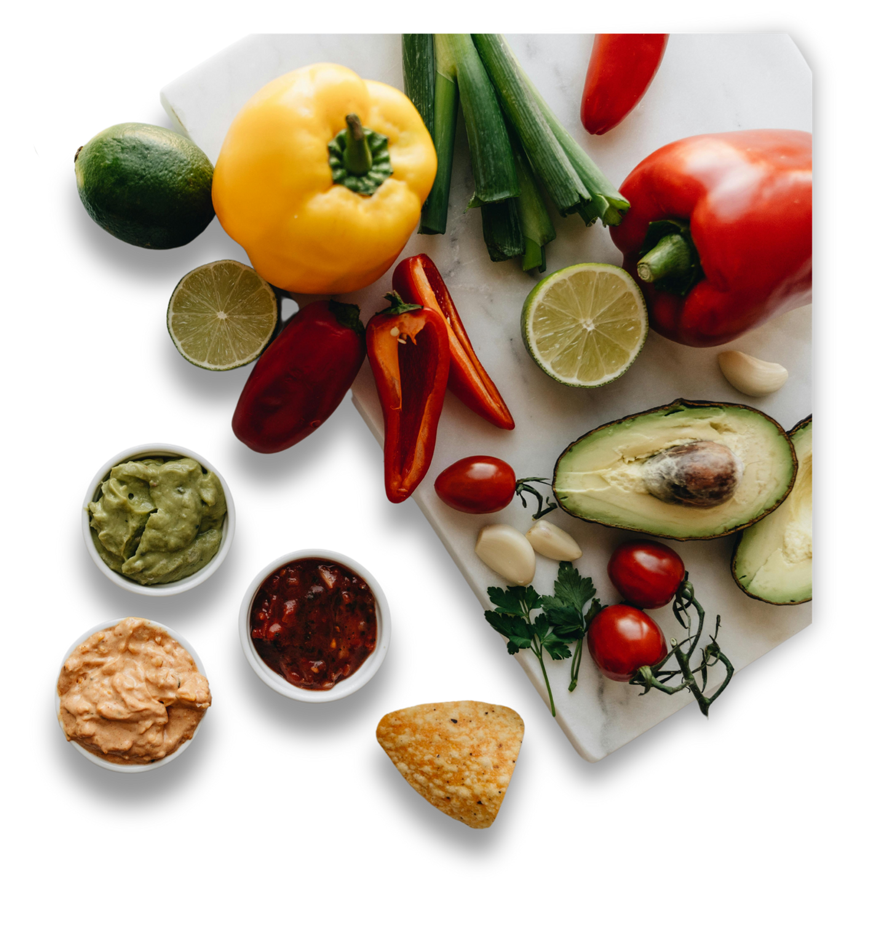

NUTRIFIT
An AI BASED DIET RECOMMENDATION SYSTEM

Slide 2
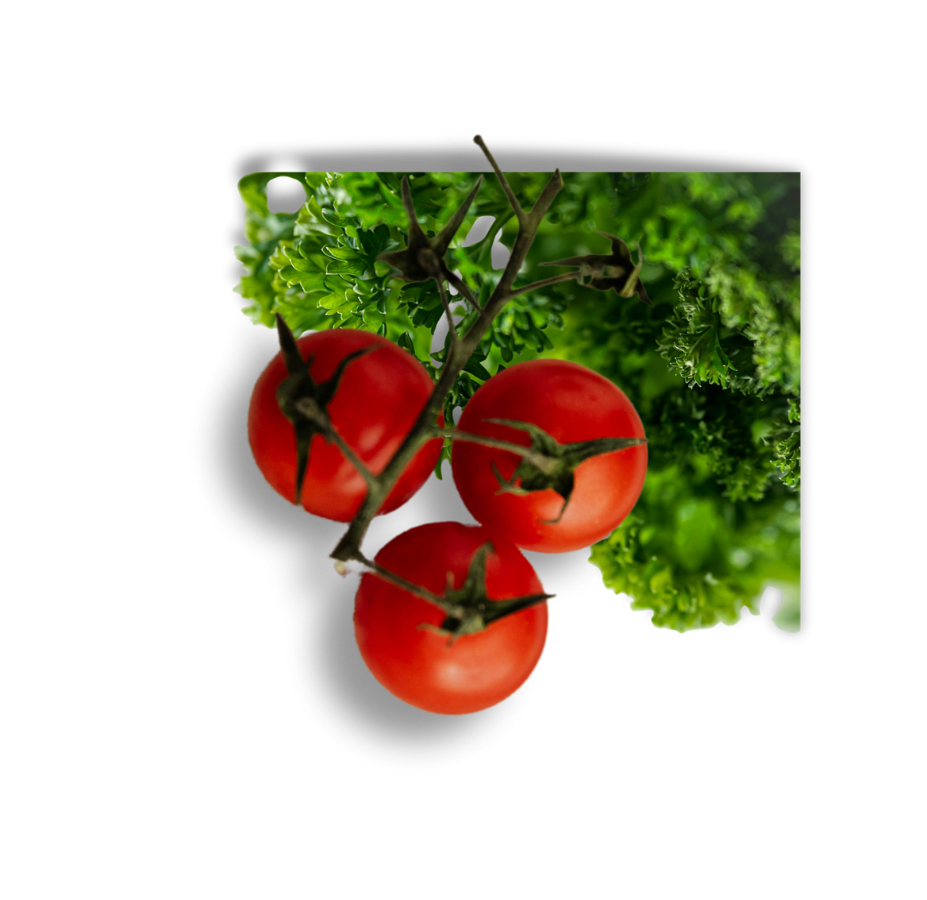
Presented By
2022- CS-112
2022- CS-151
Saba Shahdin
Afeera Fatima

Slide 3
Introduction
This project is a personalized diet recommendation system designed to help users manage their nutritional needs based on their physical characteristics, activity levels, and dietary preferences.
By collecting essential user data such as age, weight, height, gender, and activity level, the system calculates key metrics like BMI and daily calorie requirements.
Using this data, the system generates customized meal plans that consider food preferences and allergen restrictions.
A machine learning model is employed to predict body mass, and the system provides flexibility for users to modify their meal plans over time, ensuring adaptability and long-term usability.

Slide 4
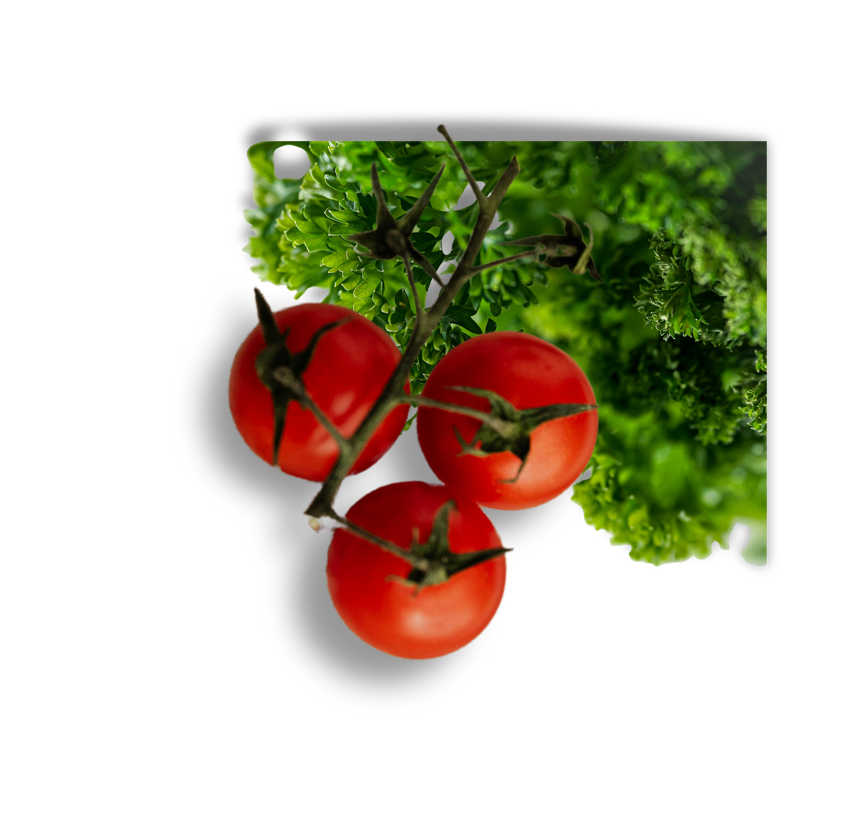
Contact
Approach
01.
02.
03.
BMI Class
Recommendation
Food Allergies
Predicts BMI Class of User suing KNN
Used Content Based Filtering to recommend according to user preference
Remove Dishes with Allergic Food Ingredients

Slide 5
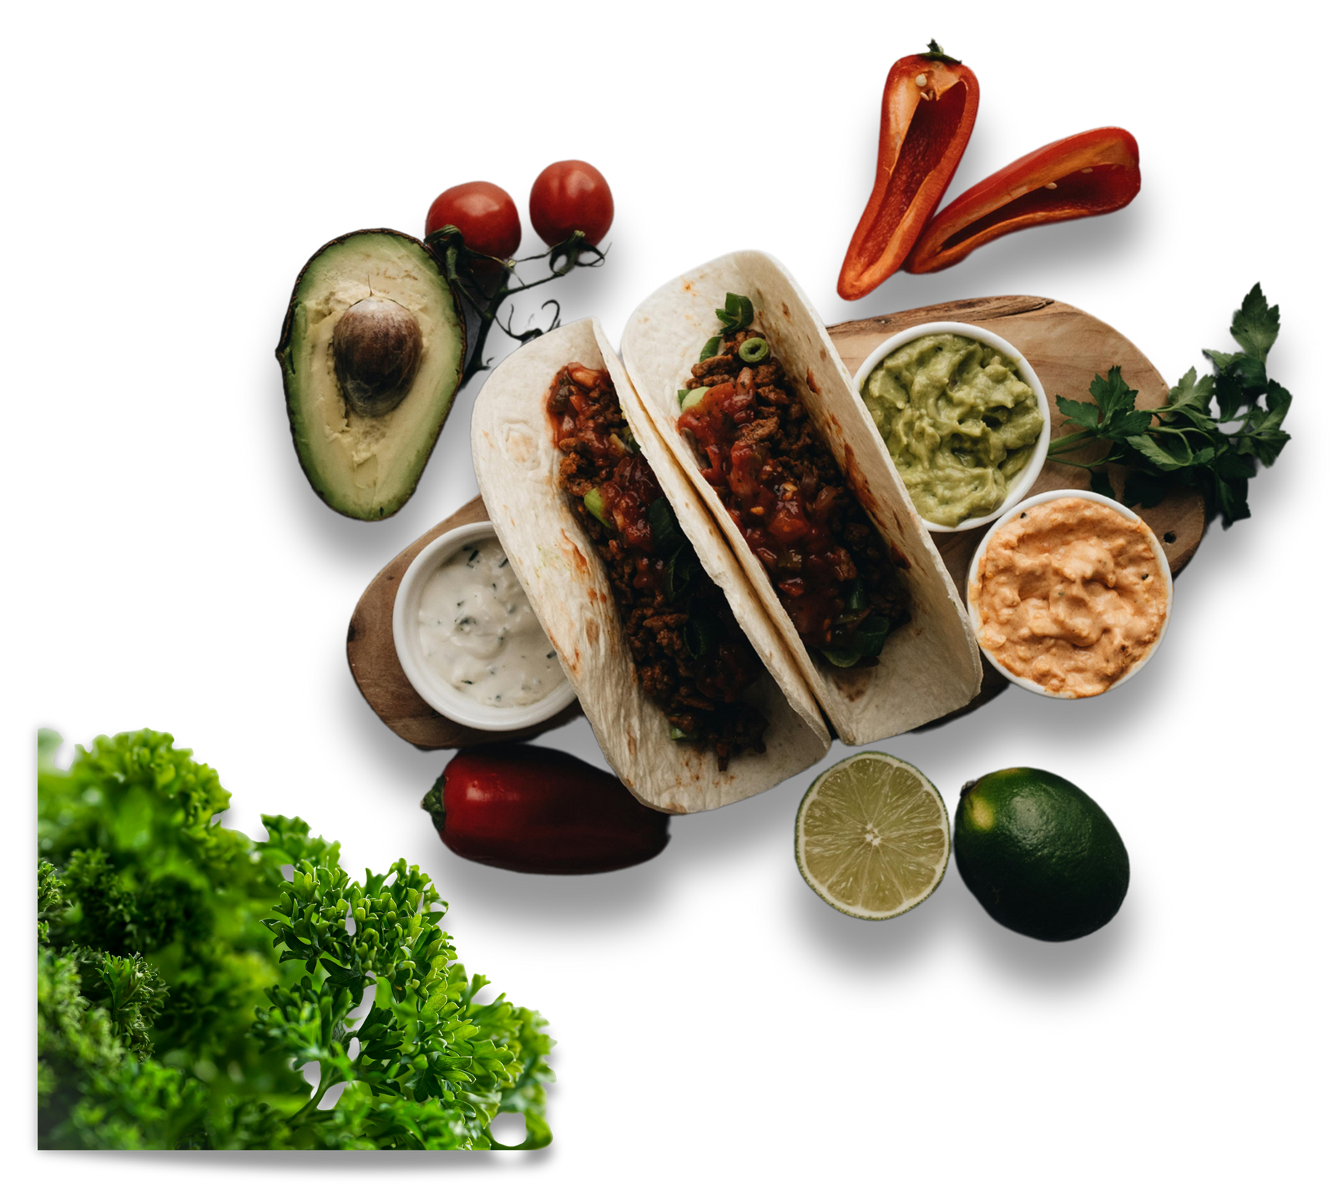
Input User Preferences
Age
Weight
Height
Gender
Physical Activity
Food allergies

Slide 6


Processing
Calculate Total Calories and Break them into Macro Nutrients
Predict BMI Class

Slide 7
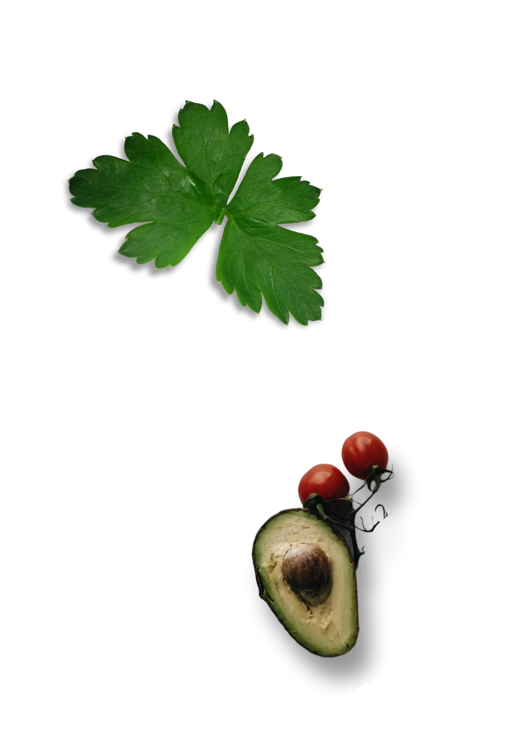


OUTPUT
Recommend Foods which aligns with user body Needs (Calories , Fats , proteins)
Recommend Foods using Content Based Filtering and filtering by removing Food Items with Allergic Ingredients

Slide 8
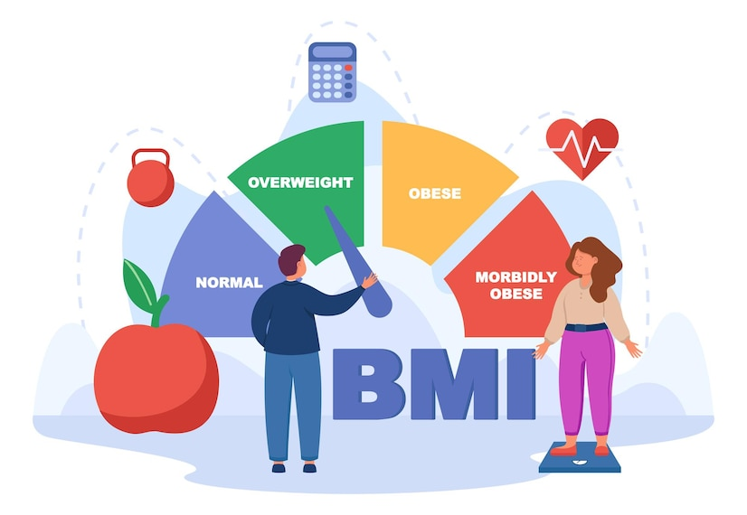
BMI Class Prediction Using KNN Model
Predict BMI class (e.g., underweight, normal, overweight, obese class1 , obese class 2 , obese class 3) based on input features using KNN (K Nearest Neighbor)

Slide 9
KNN Accuracy
K Nearest Neighbor predicts the BMI class with the accuracy of 0.92 and the precision , recall and F1 score of the predict BMI classes will be analyzed by the below table
 | Precision | Recall | F1 Score
Normal Weight | 0.98 | 0.94 | 0.96
Obese Class 1 | 1.00 | 0.50 | 0.67
Obese Class 2 | 0.72 | 1.00 | 0.84
Obese Class 3 | 1.00 | 0.84 | 0.91
Overweight | 0.93 | 0.98 | 0.96
Underweight | 0.90 | 0.96 | 0.93

Slide 10

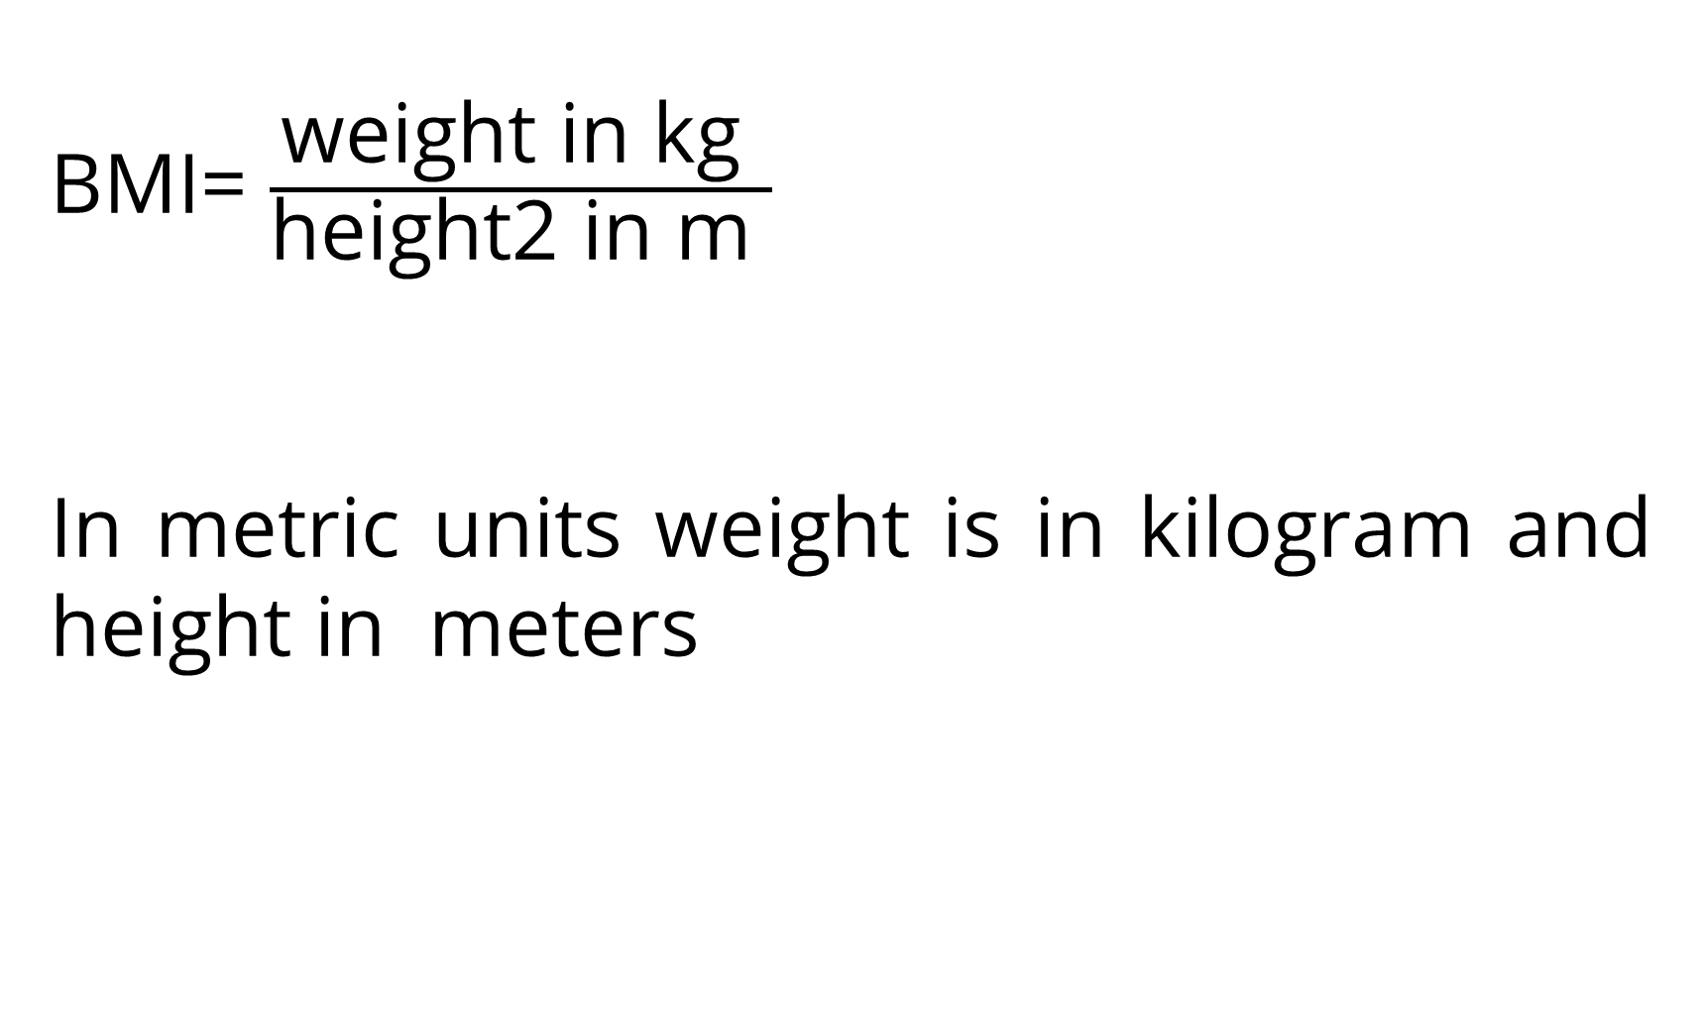
BMI CALCULATION
BMI= $\frac{\text{weight} \text{in} \text{kg} }{\text{height}\text{2 }\text{in} \text{m} }$
In metric units weight is in kilogram and height in meters

Slide 11
Calories Calculation
Using Mifflin St. Jeor calculate a person’s basal metabolic rate (BMR)
BMR (kcal/day) = 10 × weight (kg) + 6.25 × height (cm) – 5 × age (y) + s (kcal/day),
where s is +5 for males and -161 for females.

Slide 12
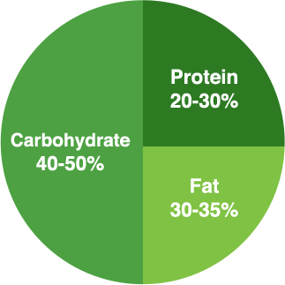
Breakdown into Macronutrients
Macronutrient Calories Distribution (Percentage):
Protein Calories = TDEE × 30%
Fat Calories = TDEE × 30%
Carb Calories = TDEE × 40%
2. Calories to Grams Conversion:
Protein (g) = Protein Calories ÷ 4
Fat (g) = Fat Calories ÷ 9
Carbs (g) = Carb Calories ÷ 4

Slide 13





Content Based Filtering
Content-based filtering is a recommendation technique that suggests items to users based on the features of the items they have interacted with in the past. It relies on comparing item attributes and user preferences.
Extract Calories and
Macronutrients
Compare cosine similarity score
Most similar food items
Input User Preferences
Food Items with their
nutrients Values

Slide 14

Allergens Detection
Analyze the user input allergies using fuzzy words and remove food items with allergens ingredients by comparing them using phrase matcher.

Slide 15
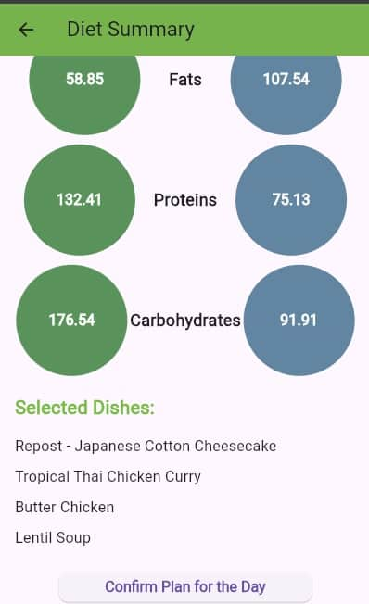
Comparison of Selected Food items
The user have a choice of selecting one food item for each category from the listed food item and then compare it with the needed nutrients.

Slide 16
Summary
Objective:
Personalized AI-based diet recommendations for improving nutritional health.
Core Features:
User input collection (age, weight, height, activity level, allergies).
BMI class prediction using a KNN model.
Custom meal plan recommendations considering caloric and nutritional needs
Removal of dishes based on allergen detection
Performance
KNN model achieves 92% accuracy in BMI classification.

Slide 17
Summary
Technology Used:
BMI calculation using the Mifflin-St Jeor formula.
BMI Class Prediction using KNN Model.
Macronutrient breakdown and calorie distribution.
Content-based filtering for personalized recommendations.
Allergen Detection.
User Benefits:
Easy tracking of nutritional goals.
Adaptable meal plans based on user feedback and changing needs.

Slide 18
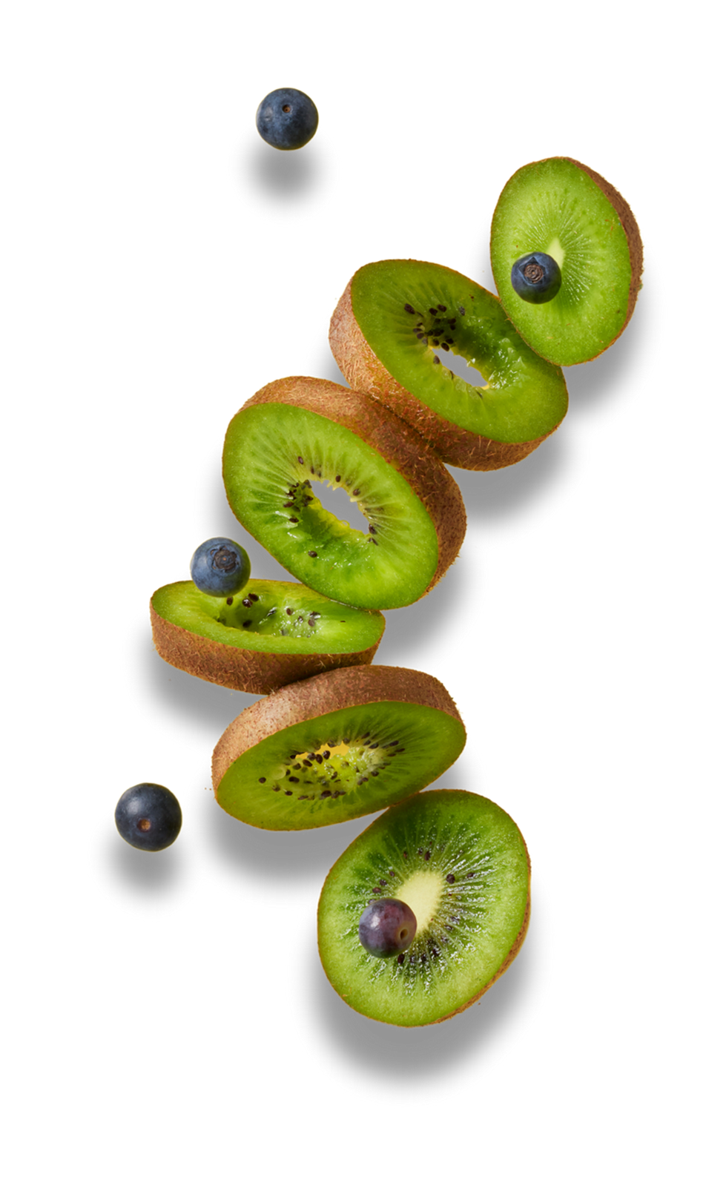
THANK YOU
We welcome your feedback and suggestions to improve NutriFit.

